Slide 1

Team 7
Conditions of Arkansas Veterans
Erije, William, Izzy, Zach, and Ben
This Photo by Unknown author is licensed under CC BY.

Slide 2
Hypothesis
Veteran patient health differs from non-service member health in the following ways:
PTSD
Substance abuse (alcoholism, opioid addiction)
Lifespan
Employment Status
Generated Population of 1000 Arkansans above age 18

Slide 3

EDA and Visualizations:

Slide 4
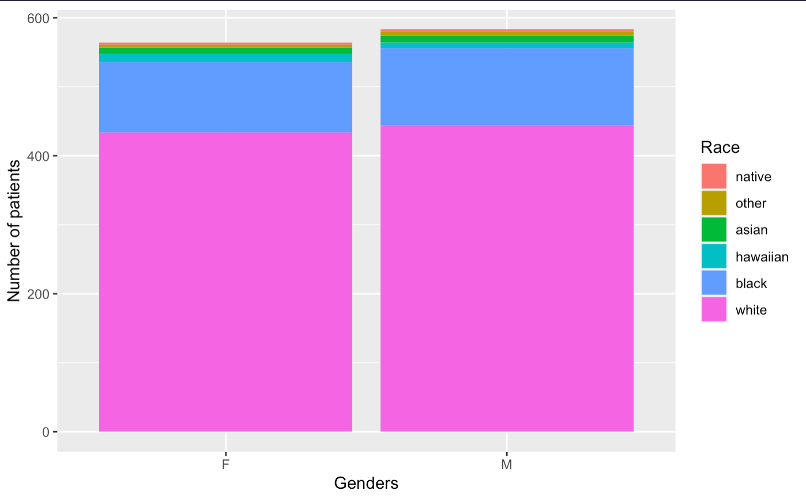
Arkansas
Patients in Arkansas per Gender and Race
Mean veteran age 66, med 69
Mean non-vet age 45, med 43
Veterans tend to be older
Mean veteran lifespan 69
Mean non-veteran lifespan 62
We see that the white population is larger than any other race in Arkansas
There are slightly more males than females
Generated 1,000 patients
1,147 patient records generated
147 patients have data for death date

Slide 5
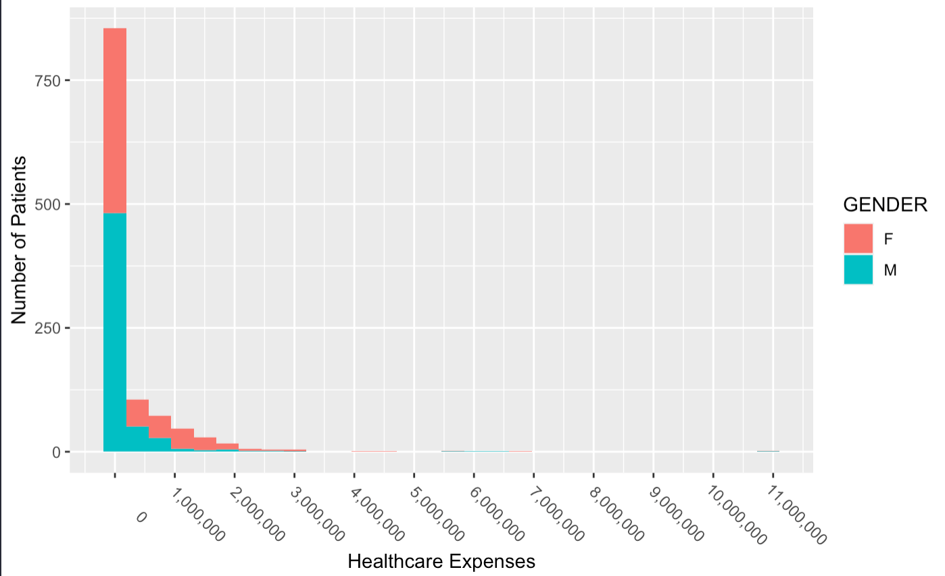
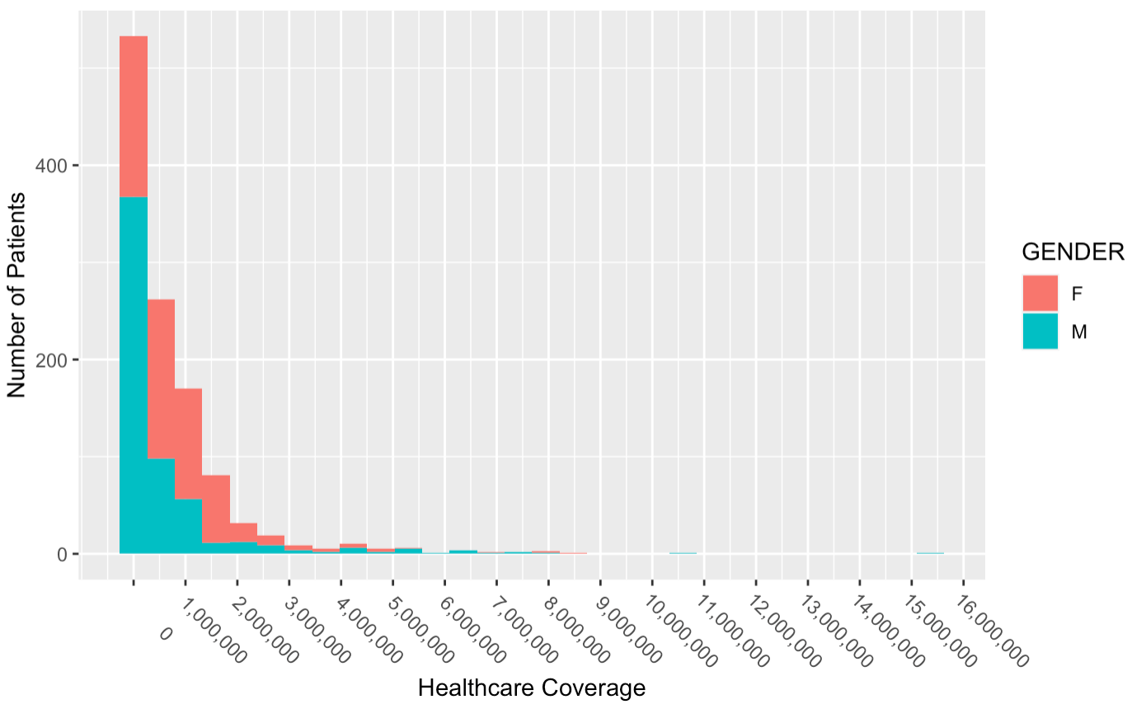
Number of Patients vs. Healthcare Expenses by Gender
Number of Patients vs. Healthcare Coverage by Gender
There is little variance between sexes
Females can run a little higher
The vast majority of expenses are below $250,000
Expenses above $2,000,000 are outliers
Healthcare coverage tapers off around $3,000,000
The healthcare coverage differs among sexes
Females receive higher coverage than males

Slide 6
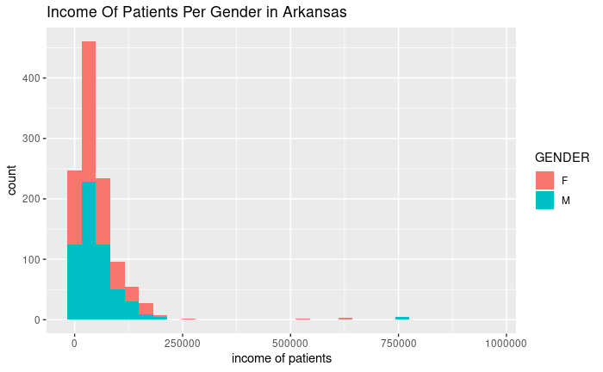
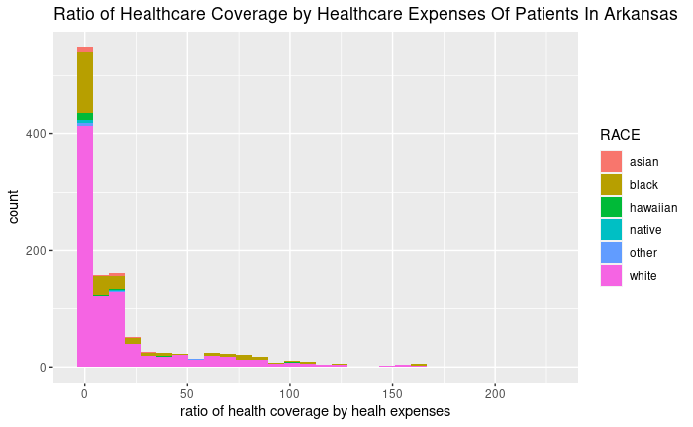
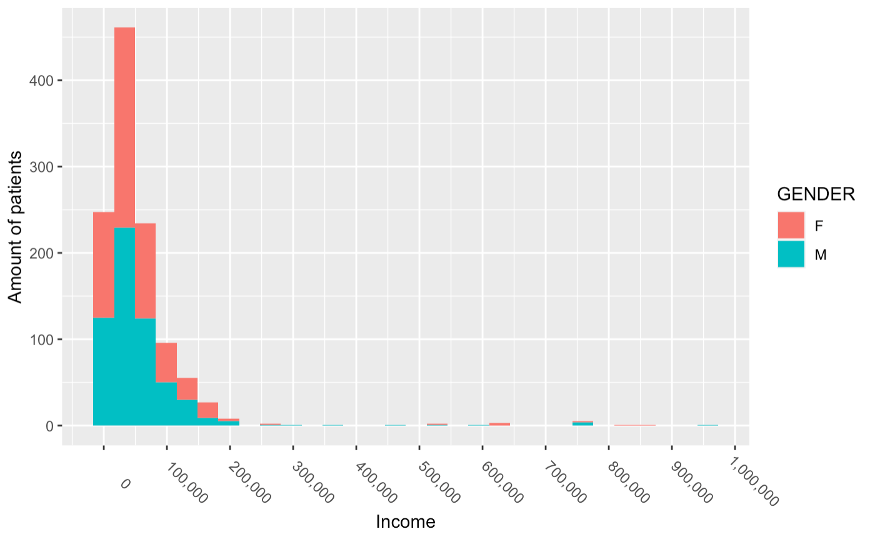
Right skewed distribution
Mean closer to 0
Most of healthcare expenses are covered
Most Arkansans make less than $100,000
Average income $57,526.36
Median income $37,639
Patients who’s income exceeds 200,000 may be considered outlier data

Slide 7
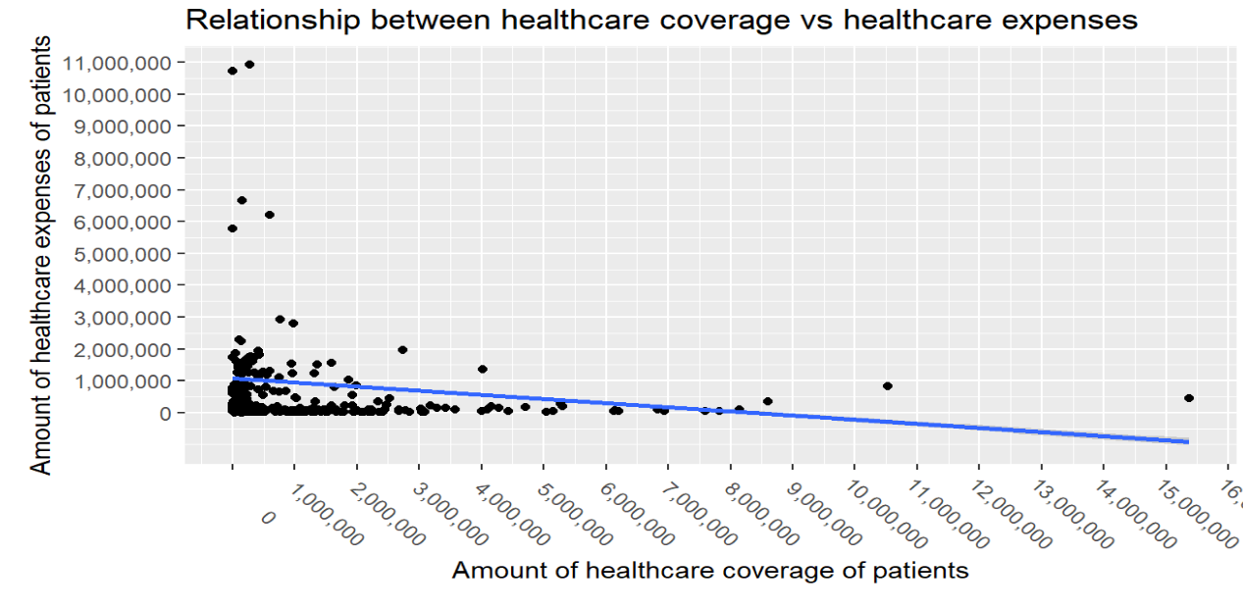
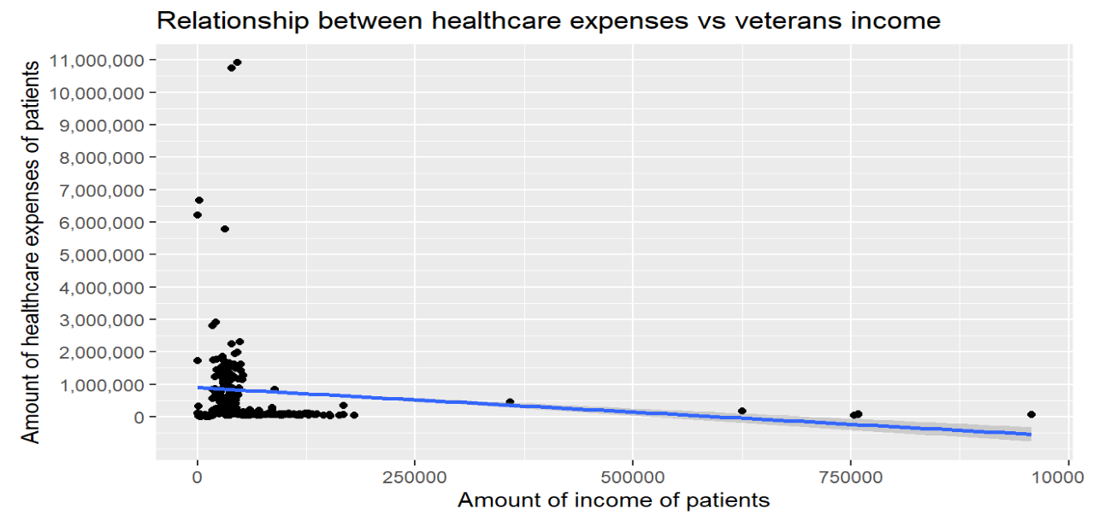
Analysis of Healthcare affordability for veteran patients in Arkansas
Negative slope
The more expensive the health expenses are the less healthcare coverage is provided
Negative slope
Veterans income seems to not be able to cover healthcare expenses

Slide 8
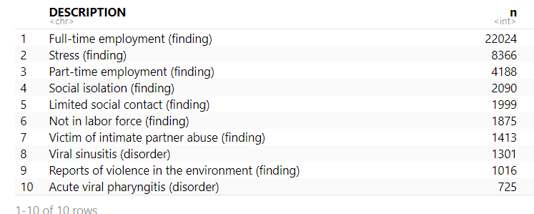
Top 10 conditions of patients in Arkansas

Slide 9
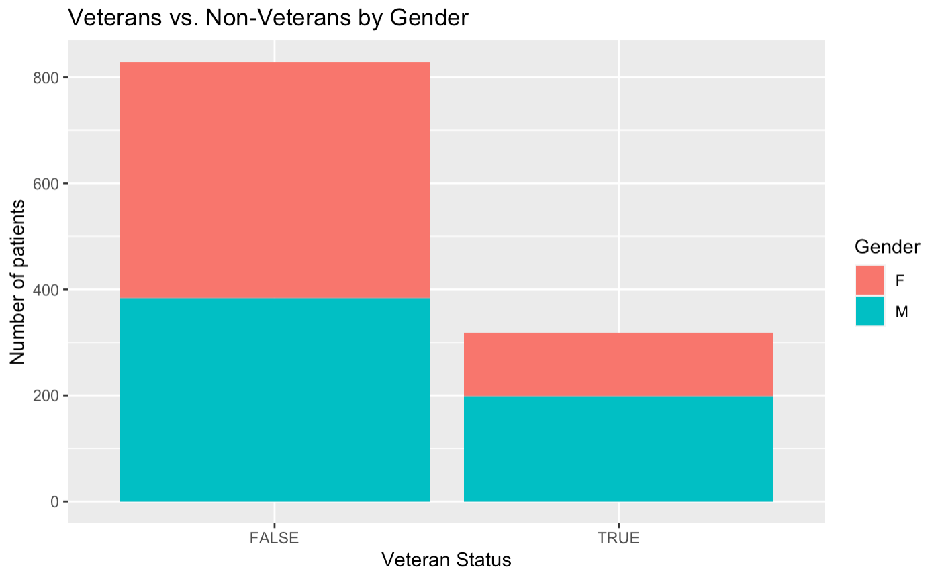
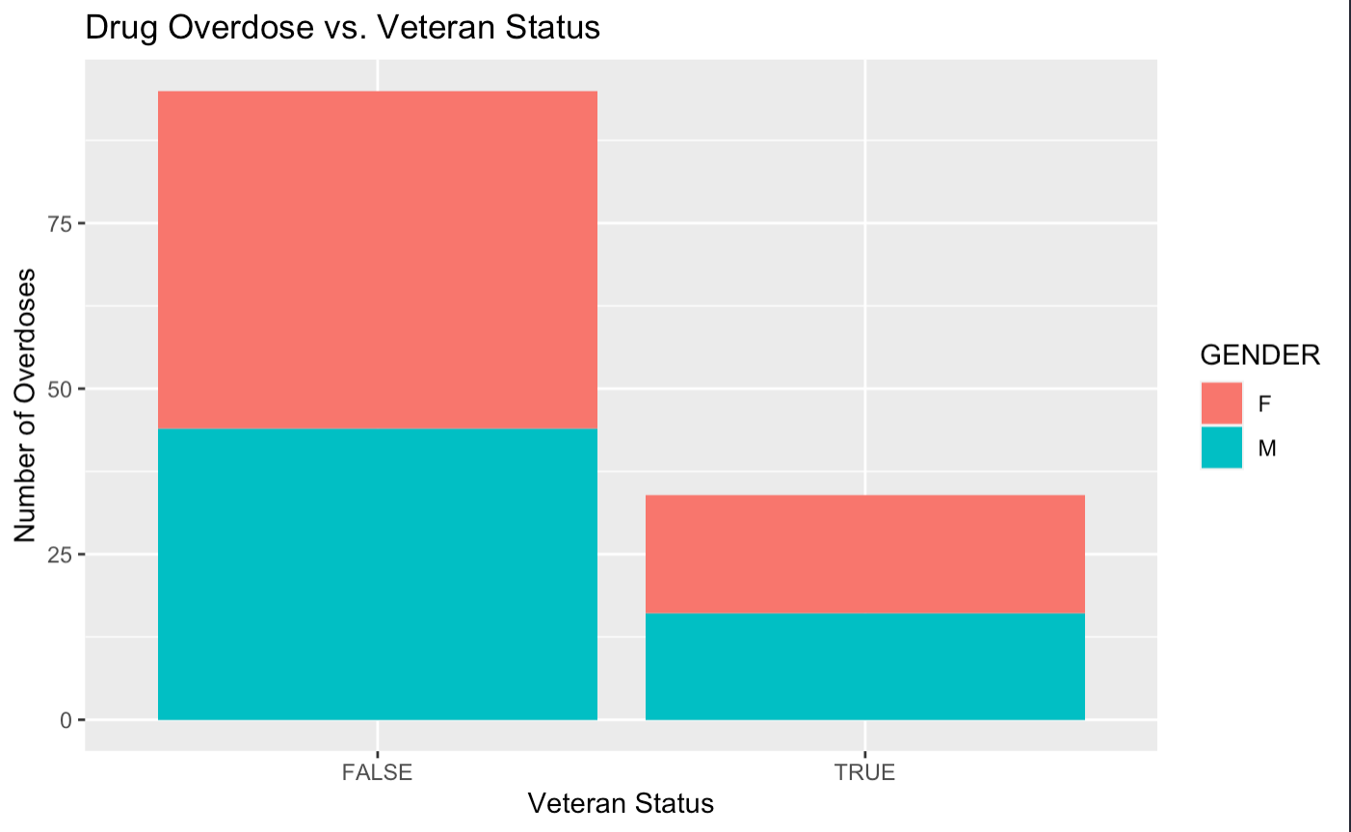
Hypothesis Testing – Substance Abuse
Miniscule gap
Difference between proportions is marginal
Proportion of overdoses is representative of entire population
More women seem to overdose than men (marginal amount)

Slide 10
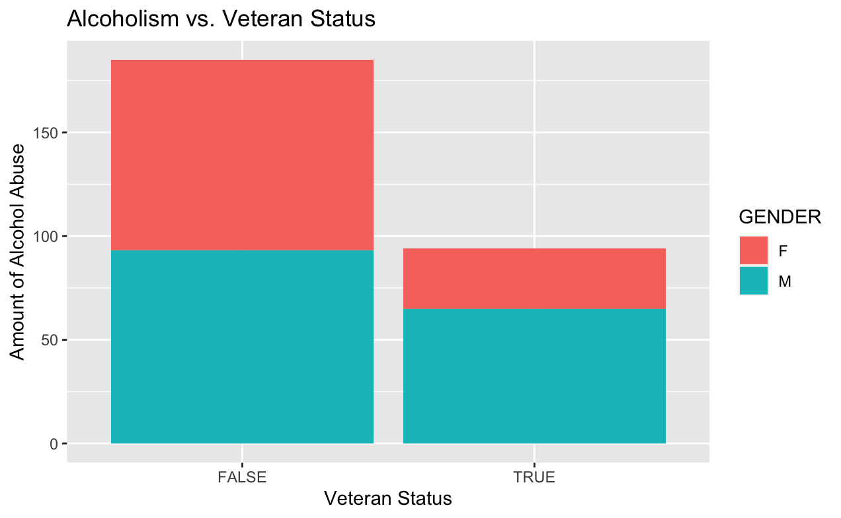
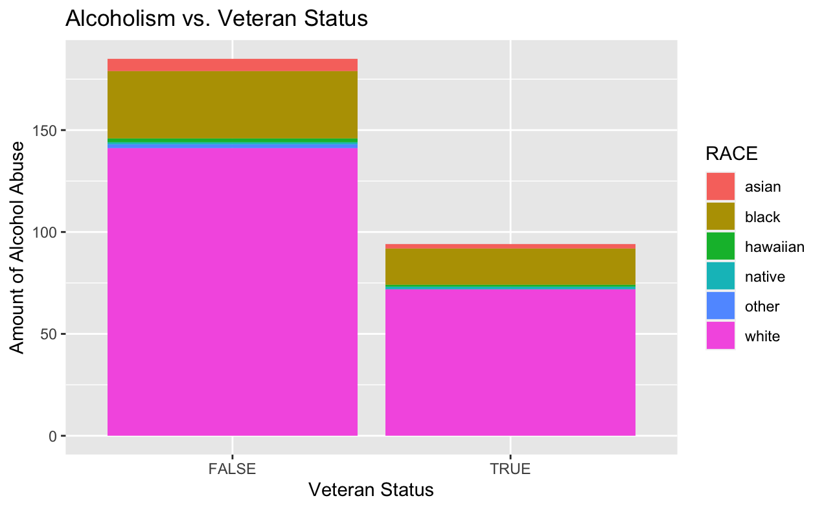
Substance Abuse
This graph tells us the relationship between alcoholism and Veterans and Non-Veterans.
More male veterans struggle with alcohol abuse than females
The proportion of vets to non-vets with respect to unhealthy drinking is slightly higher than baseline
Unhealthy Alcohol Consumption vs. Veteran Status by Gender
Unhealthy Alcohol Consumption vs. Veteran Status by Race

Slide 11
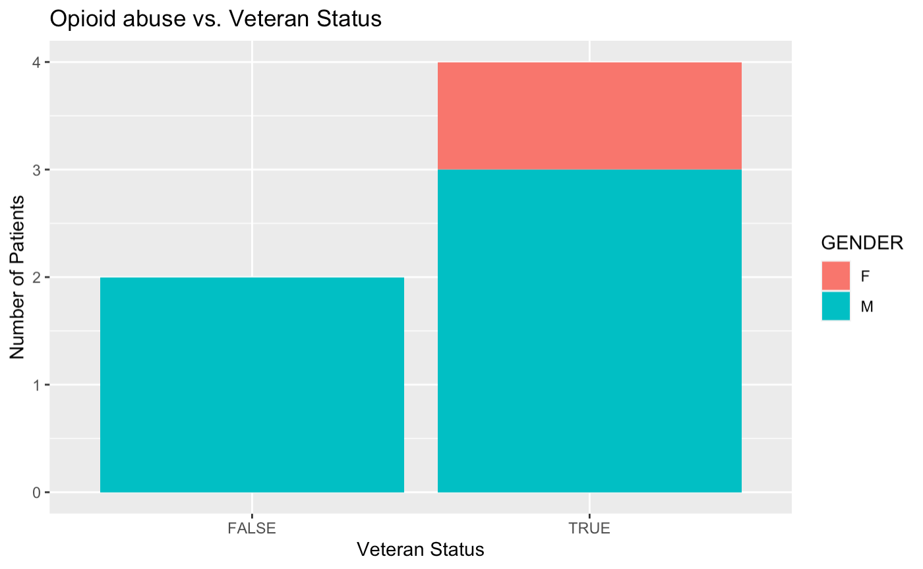
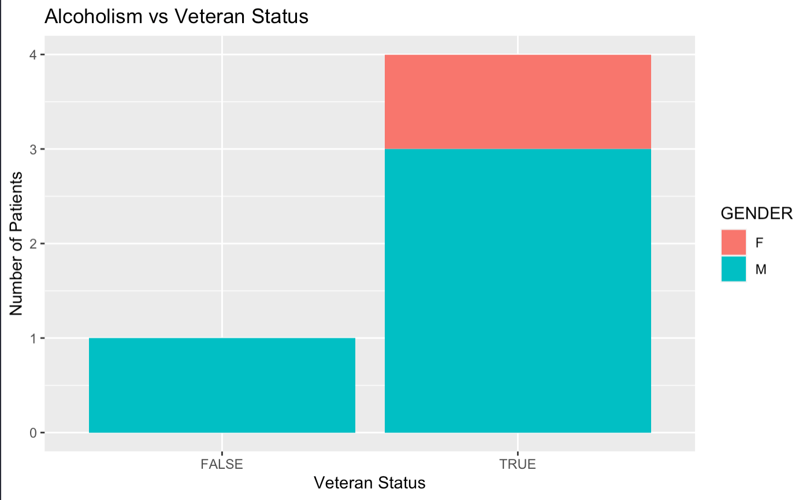
Substance Abuse
Alcoholism and Opioid Abuse predominantly affect men and veterans
Very small portion of entire population (between 5-6 out of 1100)

Slide 12
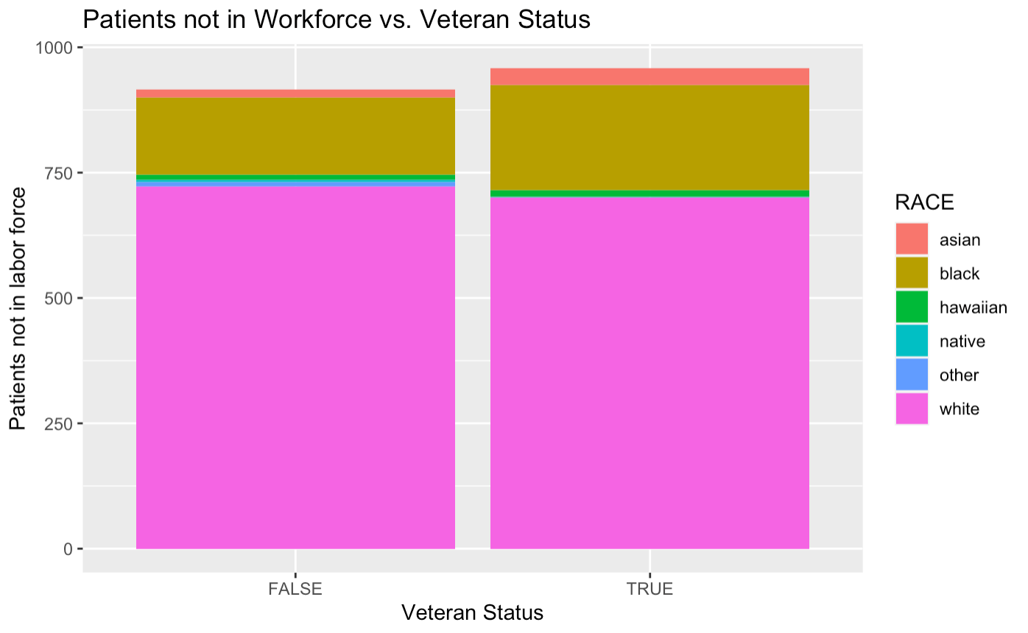
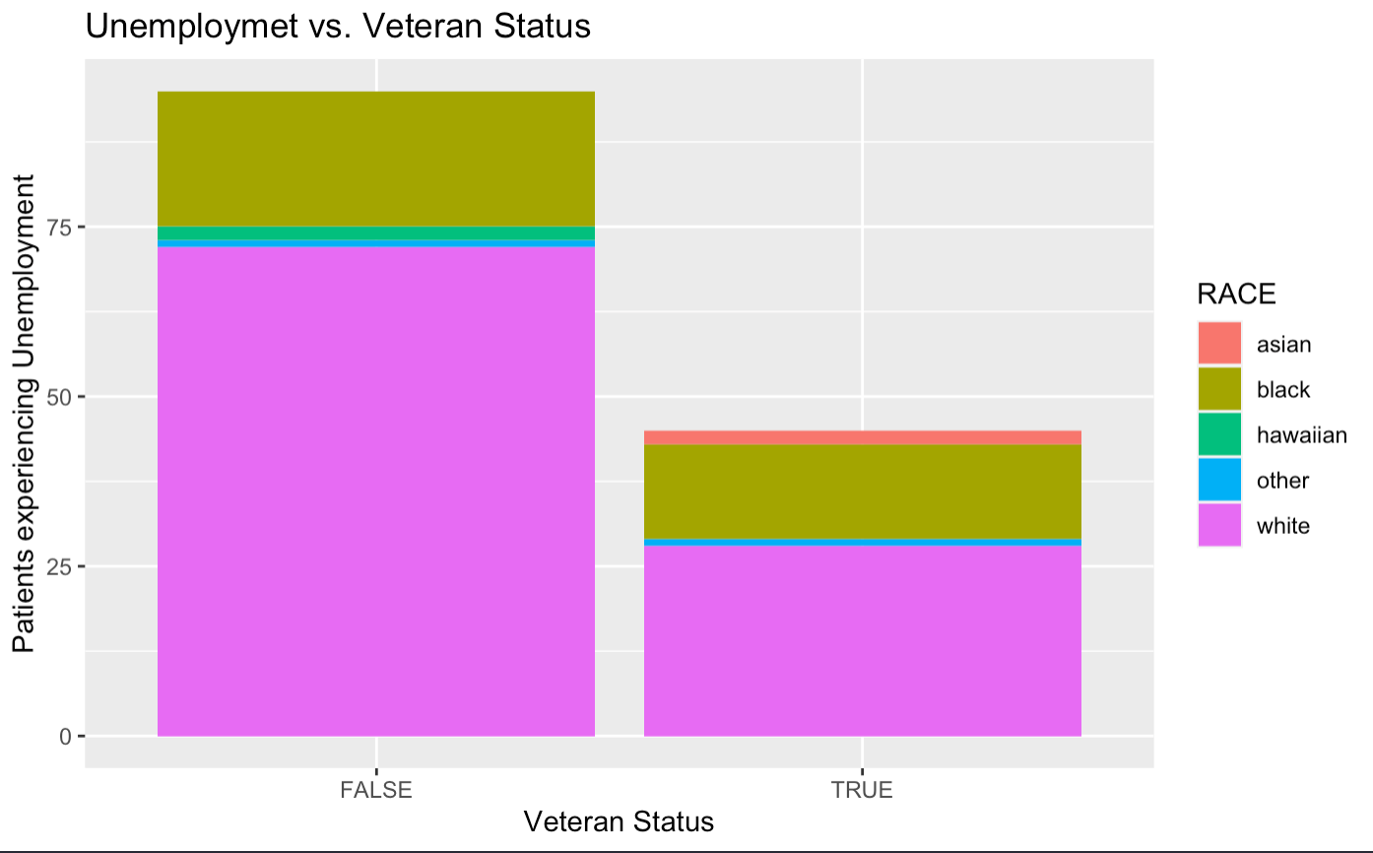
Hypothesis Testing – Unemployment
Significantly higher proportion of veterans are not in the work force compared to non-veterans
General unemployment proportion mirrors general population

Slide 13
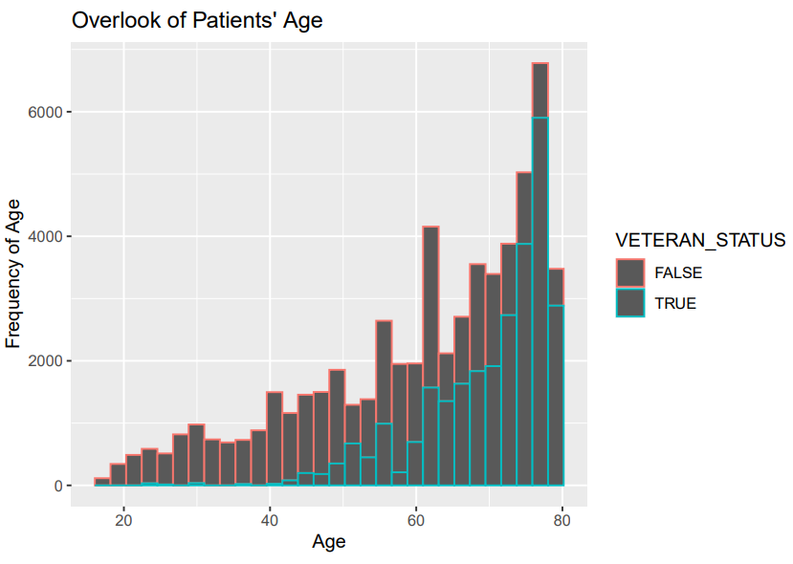
Conclusion
Veterans are more susceptible to substance abuse and unemployment.
Not many patients have PTSD (only one patient had it; was not a veteran
Veterans have slightly longer mean lifespan (7 years on average)
Veterans are not able to afford healthcare expenses because of lack of healthcare coverage and low income.
As age increases, so does the amount of conditions
Number of Total Conditions

Slide 14
Future Work
Take more time looking at raw data to see all variables
Somehow we missed variable ‘served in armed forces’
R DataCamps
Less procrastination
More in-person collaboration
Try to clean data in one program
More cohesive teamwork, clearer objectives

